Slide 1

ANAND INSTITUTE OF HIGHER TECHNOLOGY (An Autonomous Institution)
DEPARTMENT OF COMPUTER SCIENCE AND ENGINEERING
ENHANCED SECURITY FRAMEWORK:
GRAPHICAL PASSWORD AUTHENTICATION WITH
DATA HIDING ON CLOUD STORAGE
TEAM MEMBERS
GOKUL P (310121104035)
JELEN ALBERT J (310121104044)
GUIDE NAME : Mr. S. Dinakar Jose M.Tech
Assistant Professor – Computer Science and Engineering
CS3811 PROJECT WORK

Slide 2
ANAND INSTITUTE OF HIGHER TECHNOLOGY (An Autonomous Institution)
DEPARTMENT OF COMPUTER SCIENCE AND ENGINEERING
AGENDA
Domain introduction
Existing system
Problem statement
Proposed system
Objective
Scope
Architecture
Modules and description
Output screen shots
Conclusion
Future enhancements
Publication
Patent
Internship
CS3811 PROJECT WORK

Slide 3
ANAND INSTITUTE OF HIGHER TECHNOLOGY (An Autonomous Institution)
DEPARTMENT OF COMPUTER SCIENCE AND ENGINEERING
DOMAIN INTRODUCTION
The increasing reliance on cloud storage for data management and accessibility.
Growing concerns about data security and user authentication in cloud environments.
The importance of robust authentication mechanisms to prevent unauthorized access.
Introduction to graphical password authentication as an alternative to traditional text-based passwords.
Brief overview of data hiding techniques for enhanced security in the cloud.
CS3811 PROJECT WORK

Slide 4
ANAND INSTITUTE OF HIGHER TECHNOLOGY (An Autonomous Institution)
DEPARTMENT OF COMPUTER SCIENCE AND ENGINEERING
EXISTING SYSTEM
Current authentication relies heavily on text-based passwords and basic encryption(e.g., username/password)
These systems are vulnerable to attacks like brute-force, phishing, and keylogging(e.g., susceptibility to phishing, brute-force attacks, memorability issues).
They offer limited protection and poor memorability, causing users to reuse or reset passwords.
File sharing lacks robust encryption and access control.
This leads to security vulnerabilities and inefficient data protection.
CS3811 PROJECT WORK

Slide 5
ANAND INSTITUTE OF HIGHER TECHNOLOGY (An Autonomous Institution)
DEPARTMENT OF COMPUTER SCIENCE AND ENGINEERING
PROBLEM STATEMENT
Traditional passwords are vulnerable to various attacks.
Users struggle with password complexity and reuse them, increasing risks.
Cloud storage faces single-point failures, risking data breaches.
Existing methods lack a fully integrated security framework.
There's a need for a user-friendly, multi-layered system with strong authentication and data protection.
CS3811 PROJECT WORK

Slide 6
ANAND INSTITUTE OF HIGHER TECHNOLOGY (An Autonomous Institution)
DEPARTMENT OF COMPUTER SCIENCE AND ENGINEERING
PROPOSED SYSTEM
The system enhances security with multi-layered image-based authentication and AES encryption.
It aims to provide secure, user-friendly, and tamper-resistant authentication and data sharing.
The authentication process involves three stages.
STAGE 1 : USERNAME & PASSWORD
STAGE 2 : GRAPHICAL IMAGE VERIFICATION USING DWT
STAGE 3 : IMAGE SELECTION USING PIN NUMBER
Users upload files that are encrypted using AES.
A file-sharing module allows secure file exchange with automatic decryption upon approval.
CS3811 PROJECT WORK

Slide 7
ANAND INSTITUTE OF HIGHER TECHNOLOGY (An Autonomous Institution)
DEPARTMENT OF COMPUTER SCIENCE AND ENGINEERING
OBJECTIVE
To develop a multi-stage graphical password authentication system.
To implement data-hiding using the DWT algorithm.
To use AES for secure data encryption and decryption.
To design a file splitting and merging mechanism for distributed cloud storage.
To provide a user-friendly system for secure data management.
CS3811 PROJECT WORK

Slide 8
ANAND INSTITUTE OF HIGHER TECHNOLOGY (An Autonomous Institution)
DEPARTMENT OF COMPUTER SCIENCE AND ENGINEERING
SCOPE
The system uses multi-stage graphical password authentication.
It includes data encryption using the AES algorithm.
Data hiding is implemented with the DWT algorithm.
The system employs distributed cloud storage.
The scope focuses on enhancing security and data protection in cloud environments.
CS3811 PROJECT WORK

Slide 9
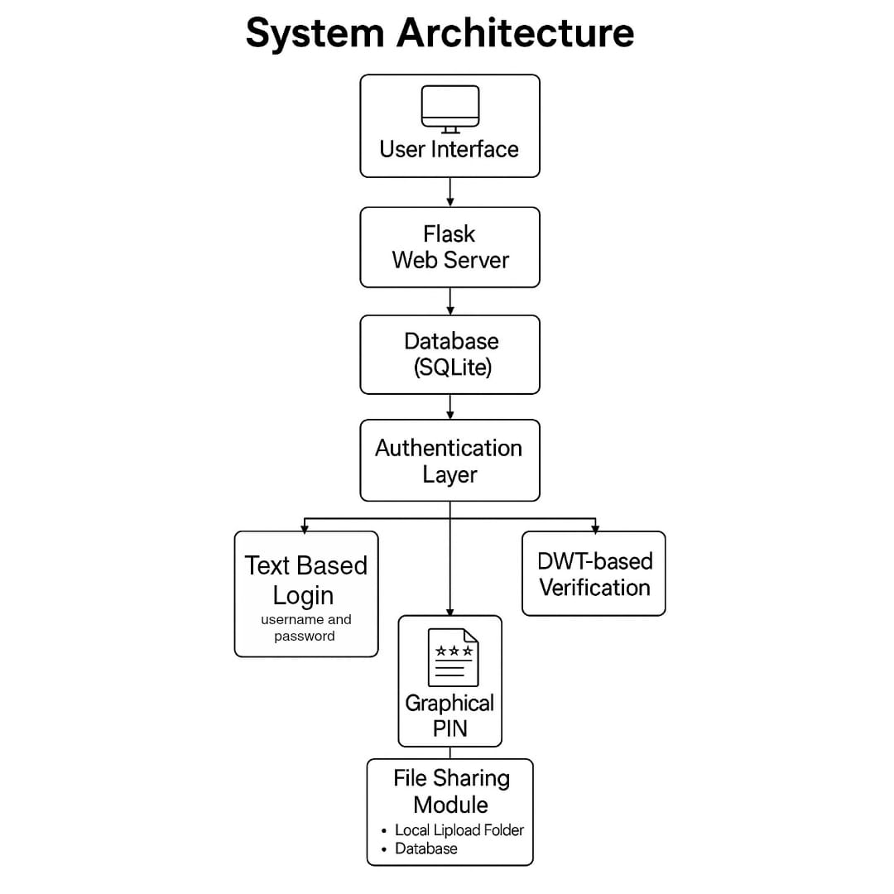
ANAND INSTITUTE OF HIGHER TECHNOLOGY (An Autonomous Institution)
DEPARTMENT OF COMPUTER SCIENCE AND ENGINEERING
DESIGN ARCHITECTURE
CS3811 PROJECT WORK

Slide 10
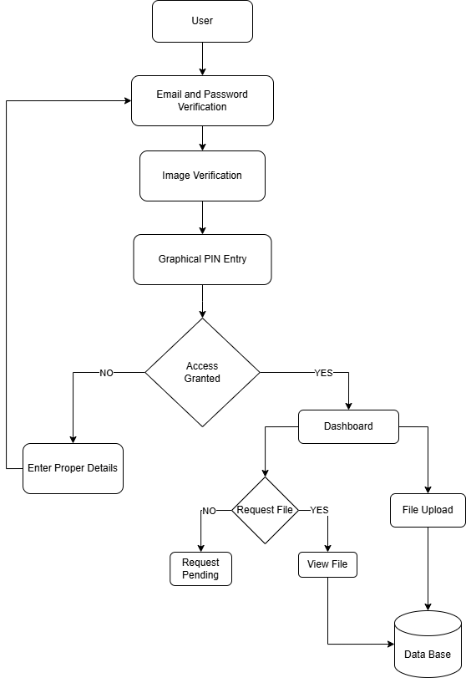
ANAND INSTITUTE OF HIGHER TECHNOLOGY (An Autonomous Institution)
DEPARTMENT OF COMPUTER SCIENCE AND ENGINEERING
DATA FLOW DIAGRAM
Provides a graphical representation of how data flows through the system, including processes for data input, storage, retrieval, and output, and the flow of data between modules.
CS3811 PROJECT WORK

Slide 11
ANAND INSTITUTE OF HIGHER TECHNOLOGY (An Autonomous Institution)
DEPARTMENT OF COMPUTER SCIENCE AND ENGINEERING
MODULE DESCRIPTION
USER REGISTRATION MODULE: Explains the user registration process, including data collected, validation procedures, and security measures.
GRAPHICAL PASSWORD AUTHENTICATION MODULE: Details the three-stage authentication process: username/password login, color sequence verification, and graphical image matching.
DASHBOARD MODULE: Describes the user dashboard and its functionalities, such as file management, sharing, and access control.
FILE SHARING MODULE: Explains how users share files, including request and approval workflows, and security considerations.
CS3811 PROJECT WORK

Slide 12
ANAND INSTITUTE OF HIGHER TECHNOLOGY (An Autonomous Institution)
DEPARTMENT OF COMPUTER SCIENCE AND ENGINEERING
MODULE DESCRIPTION
AES ENCRYPTION MODULE: Details the AES encryption process used to secure user files.
DWT-BASED STEGANOGRAPHY MODULE: Explains the use of DWT for data hiding within images.
SECURITY AND PRIVACY MODULE: Describes measures to ensure data security and user privacy.
ADMIN MODULE: Explains the functionalities available to the administrator, such as user management and system monitoring.
CS3811 PROJECT WORK

Slide 13
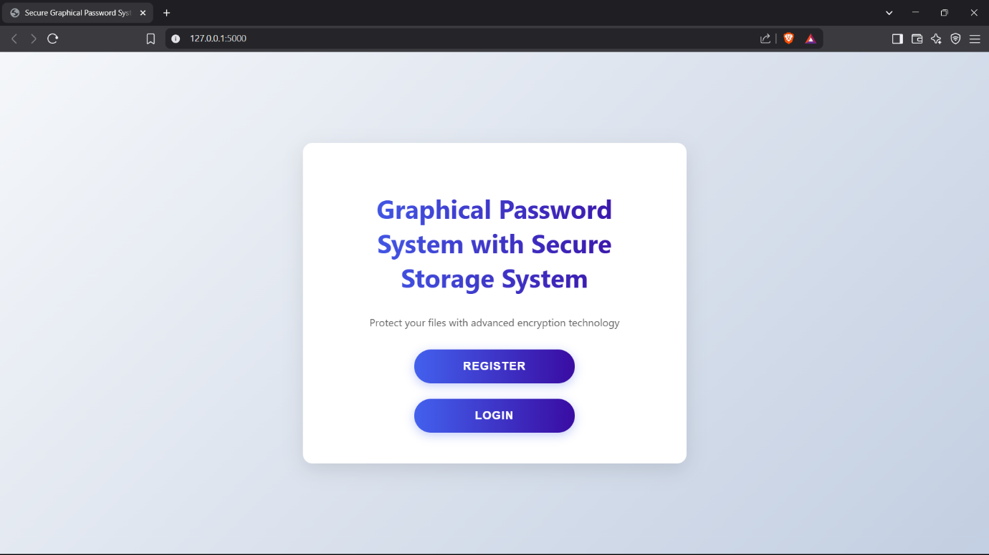
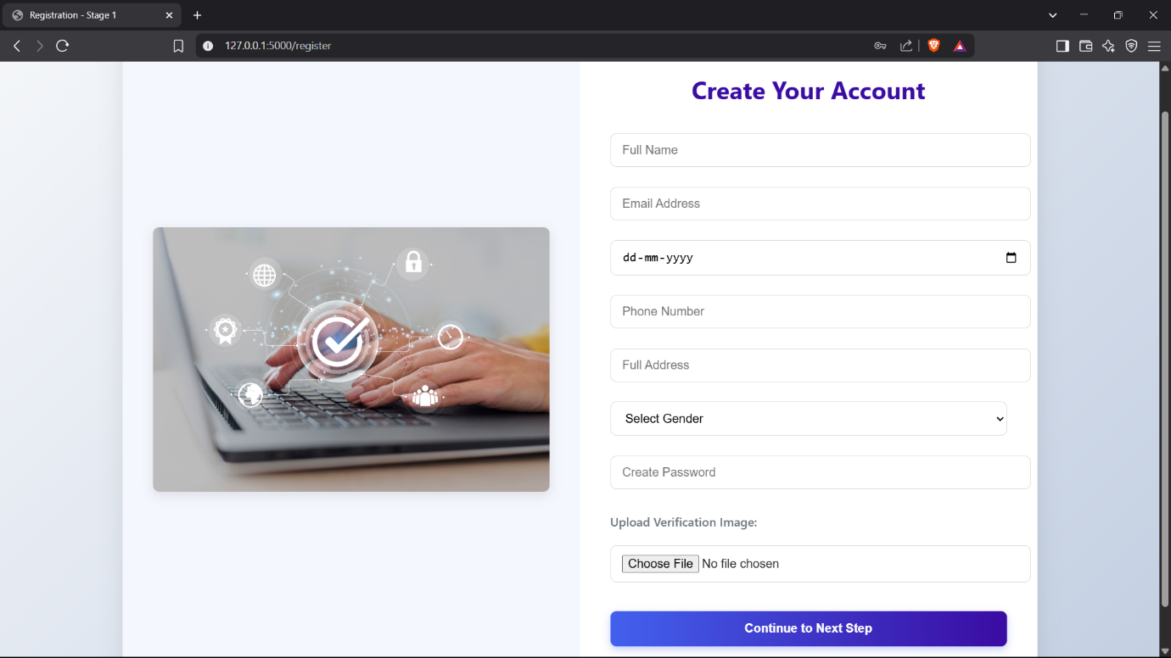
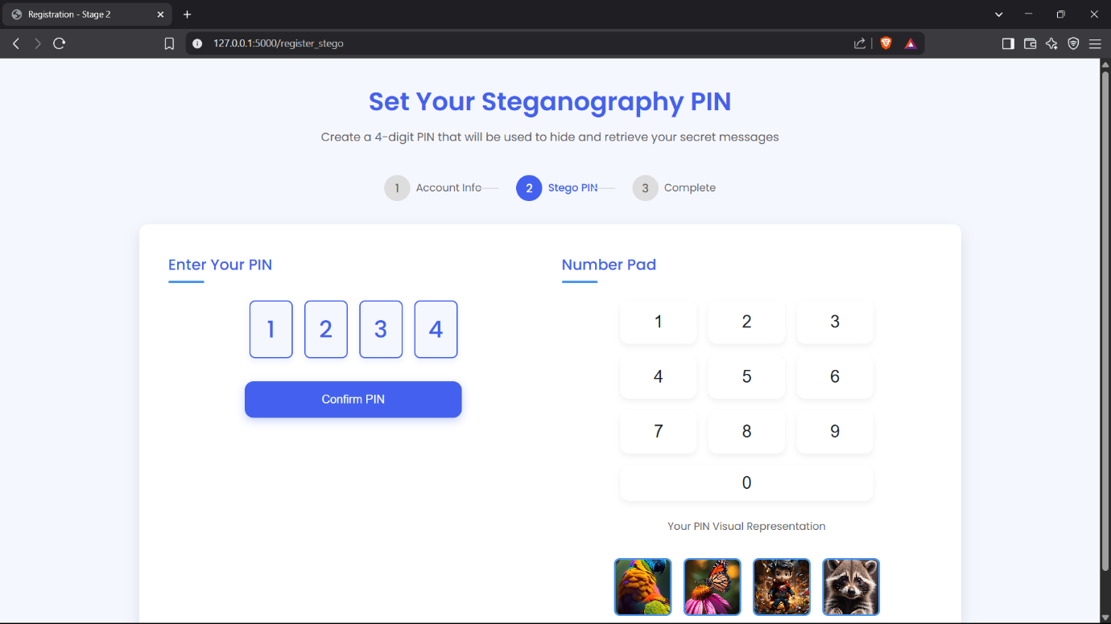
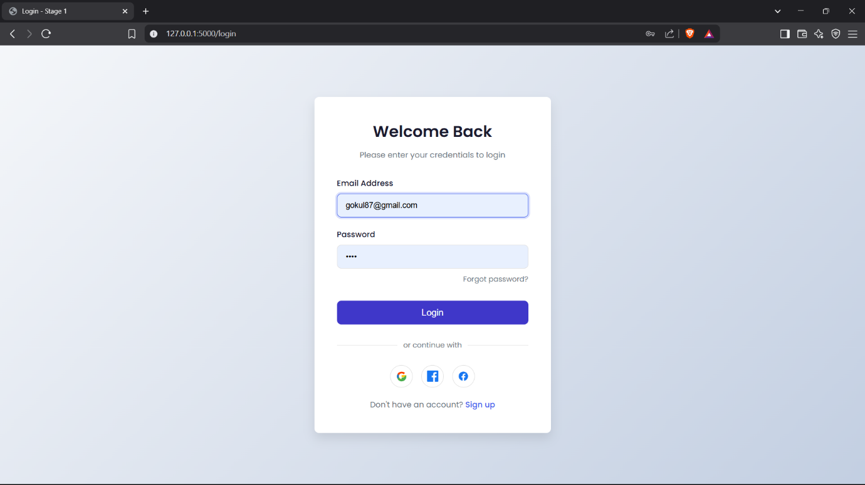
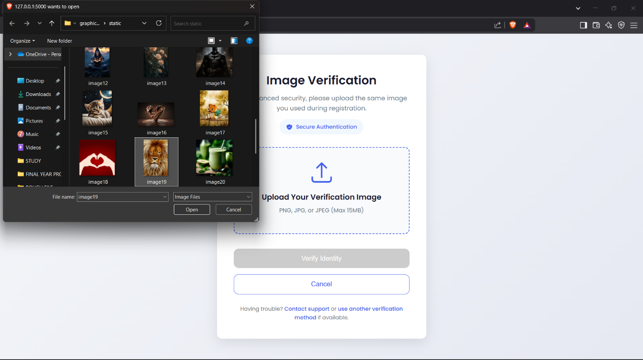
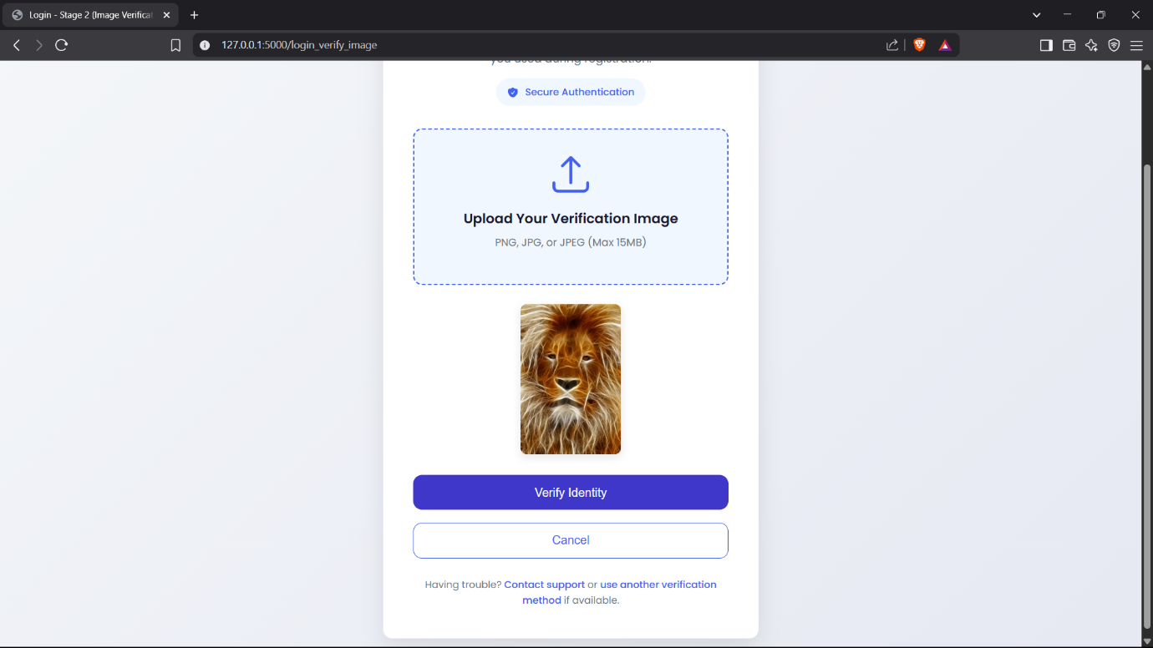
ANAND INSTITUTE OF HIGHER TECHNOLOGY (An Autonomous Institution)
DEPARTMENT OF COMPUTER SCIENCE AND ENGINEERING
OUTPUT SCREENSHOTS
CS3811 PROJECT WORK

Slide 14
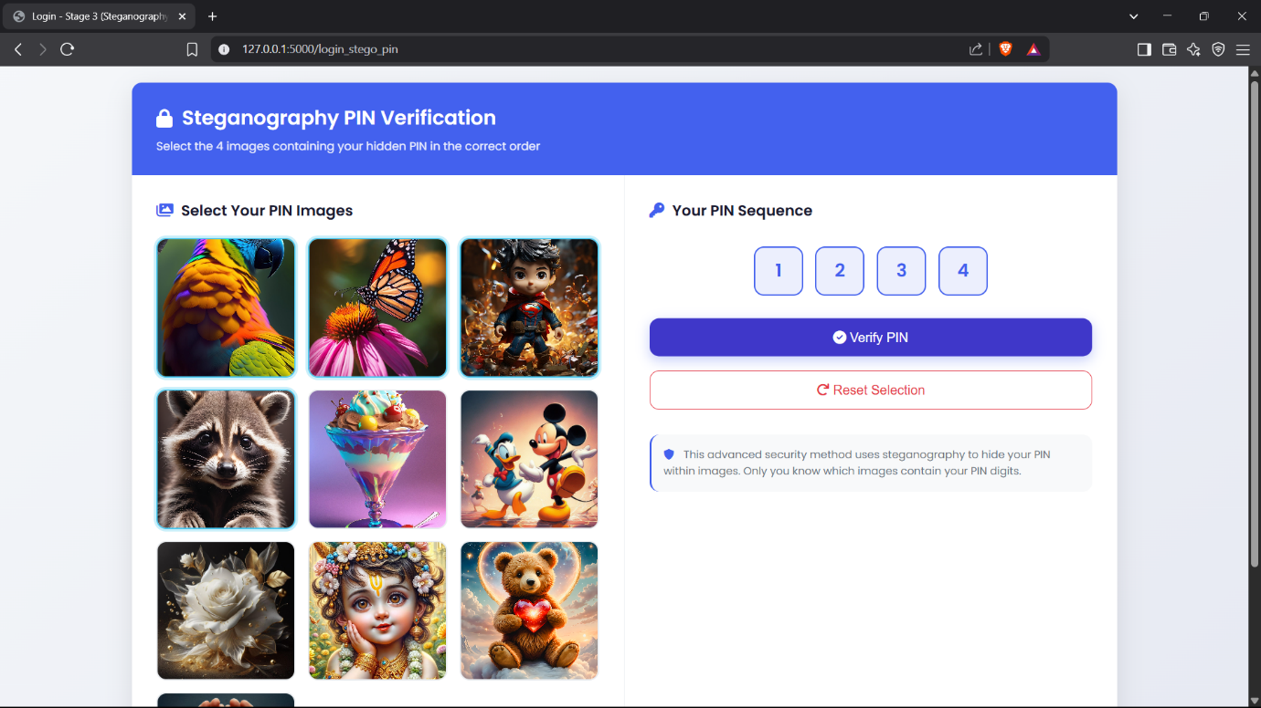
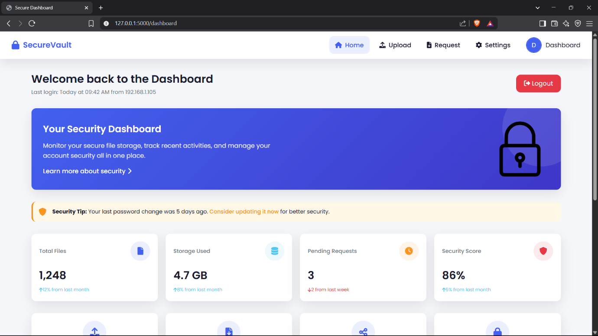
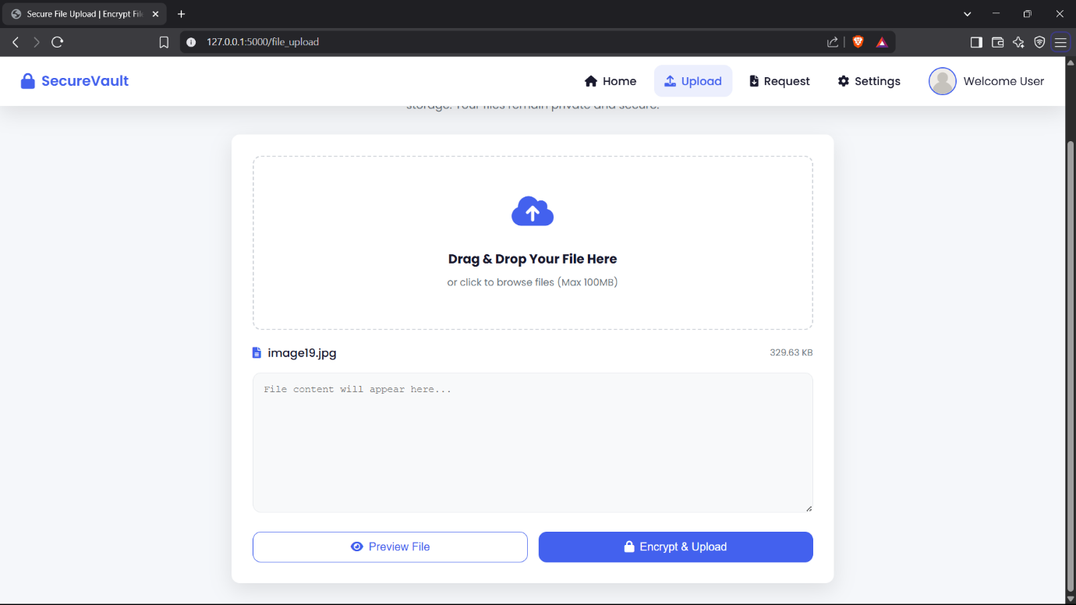
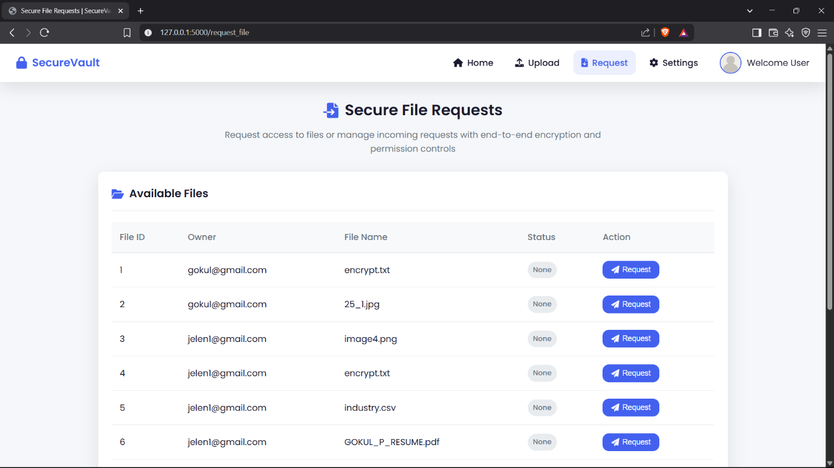
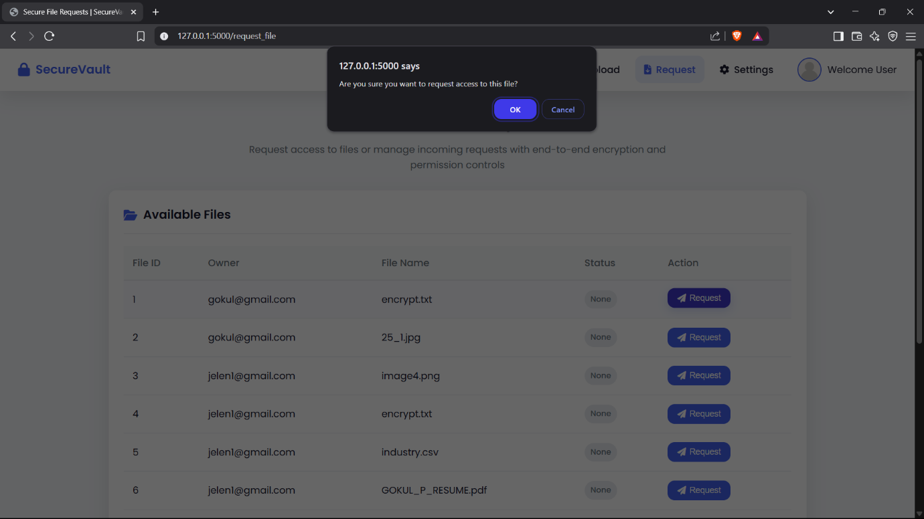
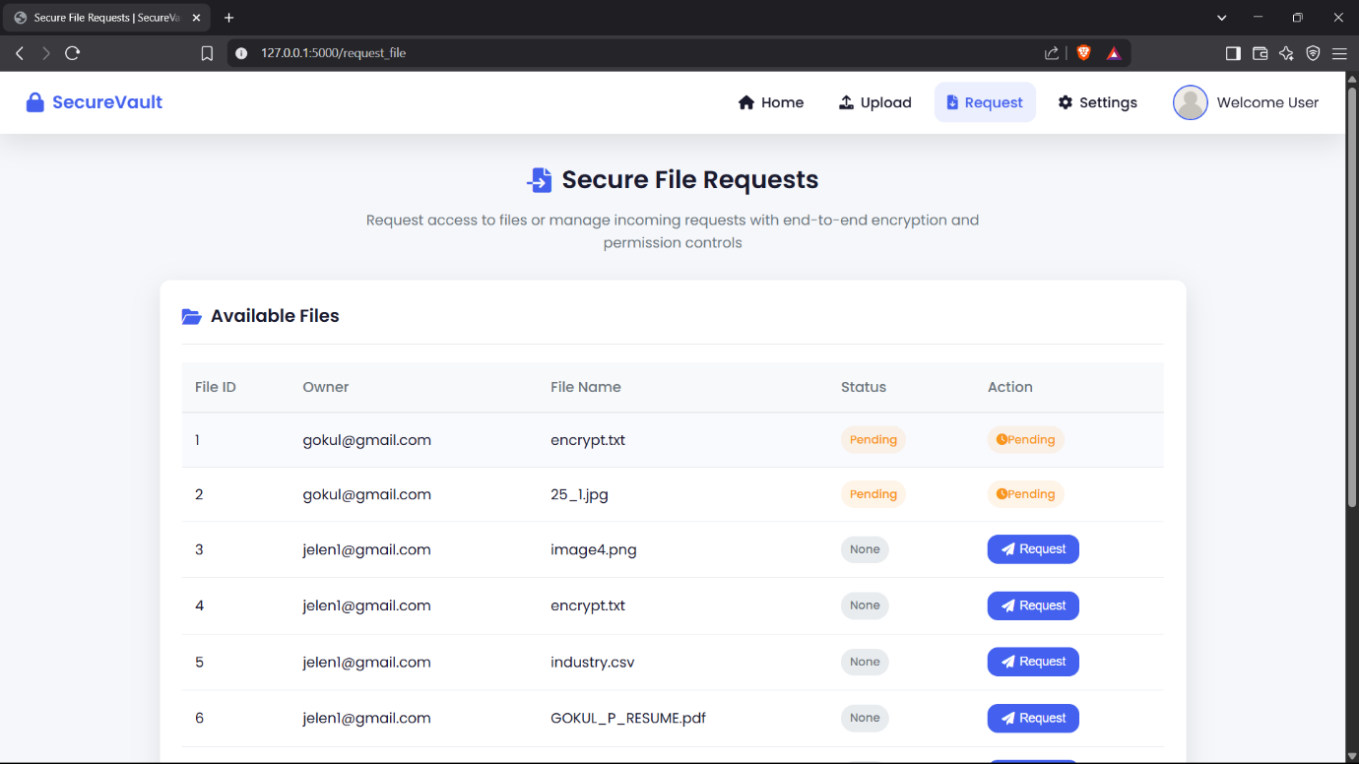
ANAND INSTITUTE OF HIGHER TECHNOLOGY (An Autonomous Institution)
DEPARTMENT OF COMPUTER SCIENCE AND ENGINEERING
OUTPUT SCREENSHOTS
CS3811 PROJECT WORK

Slide 15
ANAND INSTITUTE OF HIGHER TECHNOLOGY (An Autonomous Institution)
DEPARTMENT OF COMPUTER SCIENCE AND ENGINEERING
CONCLUSION
The system enhances security using multi-stage authentication and data hiding.
It addresses vulnerabilities in traditional authentication and cloud storage.
The framework provides a user-friendly and secure solution for cloud environments.
It integrates advanced security measures to protect user data.
The project contributes to more secure and efficient cloud storage practices.
CS3811 PROJECT WORK

Slide 16
ANAND INSTITUTE OF HIGHER TECHNOLOGY (An Autonomous Institution)
DEPARTMENT OF COMPUTER SCIENCE AND ENGINEERING
FUTURE ENHANCEMENTS
Explore additional authentication factors for enhanced security.
Implement real-time threat detection and response mechanisms.
Incorporate machine learning for adaptive security.
Extend the system to support more cloud storage providers.
Investigate blockchain technology for improved security and transparency.
CS3811 PROJECT WORK

Slide 17
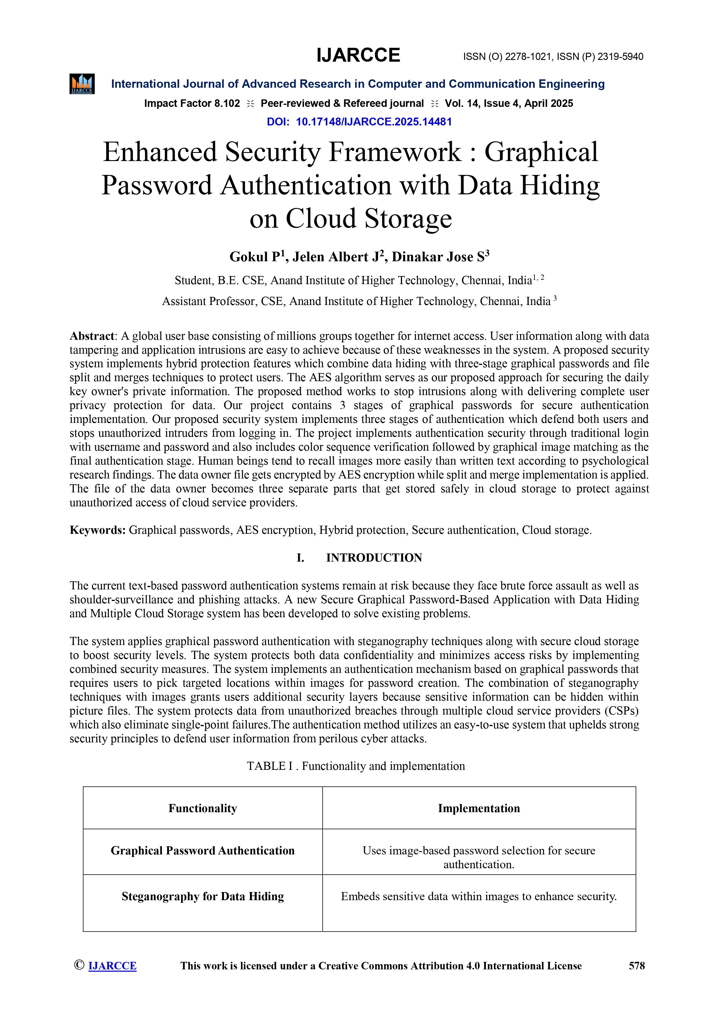
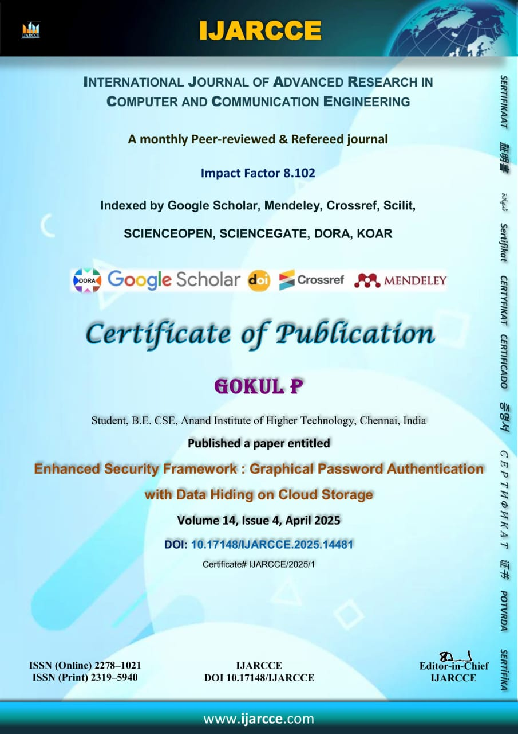
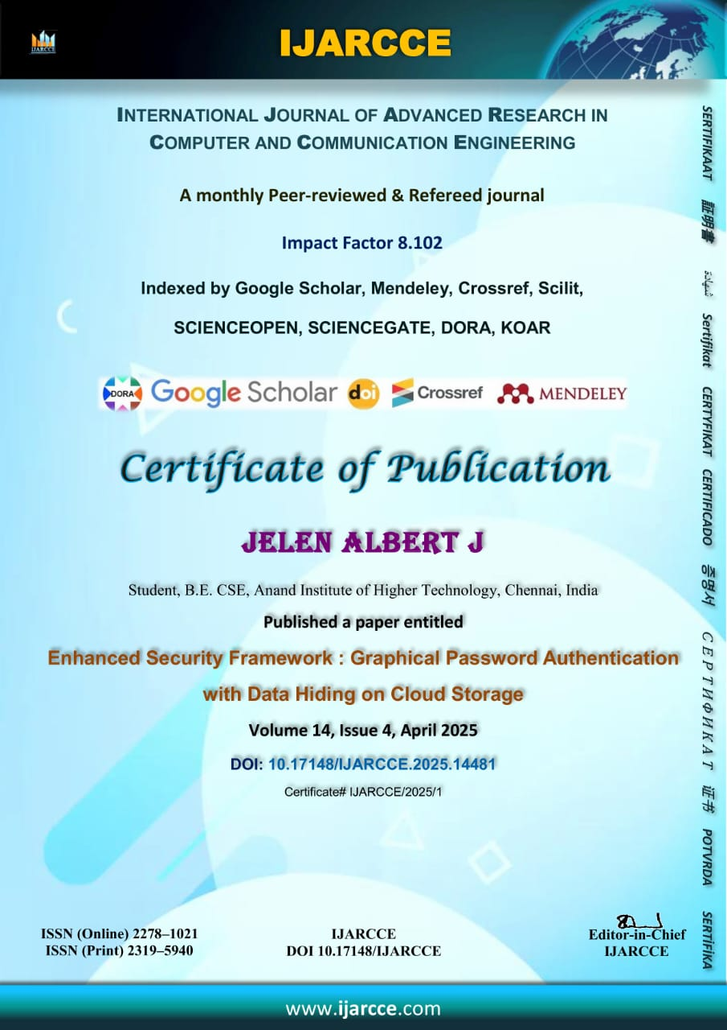
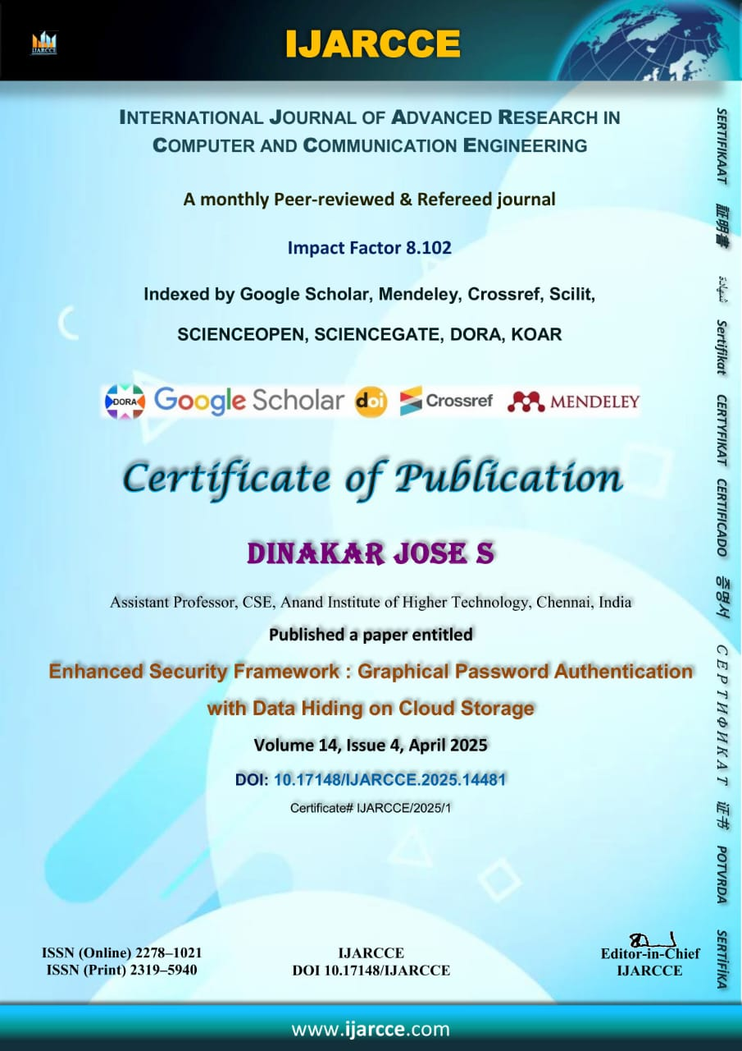
ANAND INSTITUTE OF HIGHER TECHNOLOGY (An Autonomous Institution)
DEPARTMENT OF COMPUTER SCIENCE AND ENGINEERING
PUBLICATION
CS3811 PROJECT WORK

Slide 18
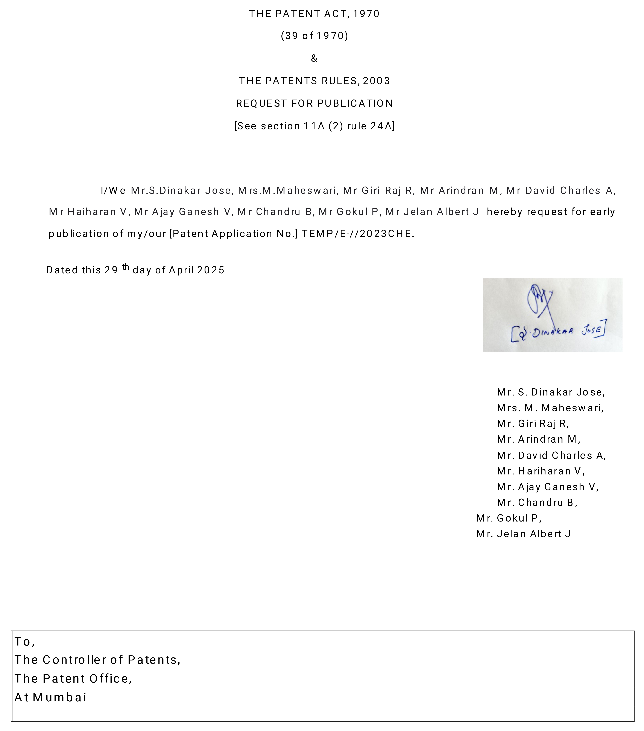
ANAND INSTITUTE OF HIGHER TECHNOLOGY (An Autonomous Institution)
DEPARTMENT OF COMPUTER SCIENCE AND ENGINEERING
PATENT
CS3811 PROJECT WORK

Slide 19


ANAND INSTITUTE OF HIGHER TECHNOLOGY (An Autonomous Institution)
DEPARTMENT OF COMPUTER SCIENCE AND ENGINEERING
INTERNSHIP
CS3811 PROJECT WORK

Slide 20
ANAND INSTITUTE OF HIGHER TECHNOLOGY (An Autonomous Institution)
DEPARTMENT OF COMPUTER SIENCE AND ENGINEERING
THANK YOU…

